Slide 1
ONLINE LOCAL TRAIN TICKET BOOKING
PREPARED BY:
PRASATH M
RA2031241040002
GUIDED BY :
DR.S.MURUGANANDHAM

Slide 2
ABSTRACT:
Online Local Train Ticket Booking using PHP scripting language. Online Local Train Ticket Booking is very useful nowadays. If the passenger was late to the railway station he/she cannot able to buy ticket(s) when train arrives at platform so he/she after entering into the train he/she can book ticket(s) using Online Local Train Ticket Booking website.
If a passenger wants to book a ticket(s), firstly, he/she has to log in to the Online Local Train Ticket Booking website with valid user id and password or you can sign up a new account. Then, the passenger has to select origin station details & destination station details ,first class or second class , one-side or return ticket and how many ticket required.
Click the pay button to book the ticket using payment gateways. After successful payment of the ticket fare the System will generate the ticket. Passenger click the print button to print the ticket or you can take screenshot. The maintenance controlled by the Admin.

Slide 3
EXISTING SYSTEM:
UTS (Unreserved Ticketing System) is an Indian Railways initiative that allows passengers to book unreserved train tickets using a mobile app. Here are some details about the existing UTS app:
Features: The UTS app provides several features, including booking and cancellation of unreserved train tickets, viewing booking history, and checking train schedules.
Ticket validity: Tickets booked through the UTS app are valid for the same day and can only be used for unreserved train travel.
Drawbacks of the Existing System:
Ticket booking restrictions: The UTS app only allows passengers to book tickets for the same day, which means that passengers cannot book tickets in advance.
QR code issues: In some cases, passengers may encounter issues with QR code-based ticketing, such as difficulty in generating or scanning the QR code.
GPS accuracy issues: The UTS app allows passengers to book ticket at a certain range and you cannot able to book ticket at railway stations.

Slide 4
PROPOSED SYSTEM:
The proposed system is user can able to book the ticket at any time, anywhere and advance booking allowed.
Converted the disadvantage feature into advantage. Now the user can able to book the tickets with no restrictions, no QR code issues and no GPS accuracy issues.
Advantages of the Proposed System:
Convenience: Online local train ticket booking allows passengers to book tickets from the comfort of their homes or offices, without the need to physically visit a ticket counter or stand in long queues.
Time-saving: Booking tickets online saves time for passengers, as they can complete the booking process in a matter of minutes.
Availability: Online ticket booking systems are available 24/7, which means that passengers can book tickets at any time, even outside of the usual ticket counter working hours.

Slide 5
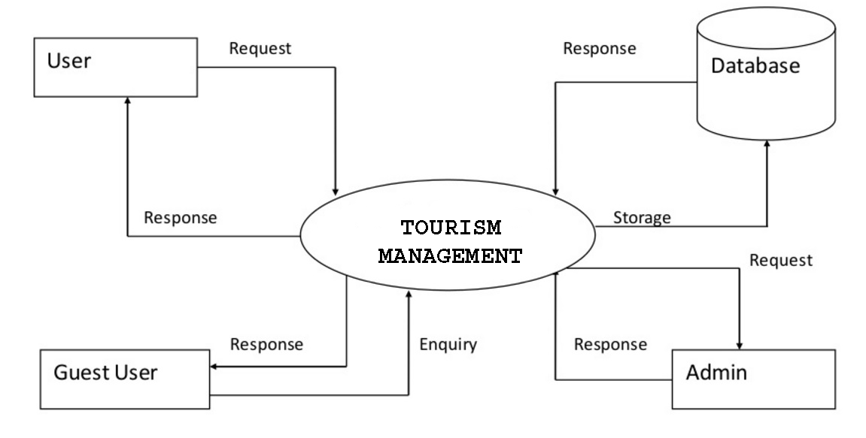
ARCHITECTURE DIAGRAM:
TOURISM MANAGEMENT SYSTEM

Slide 6
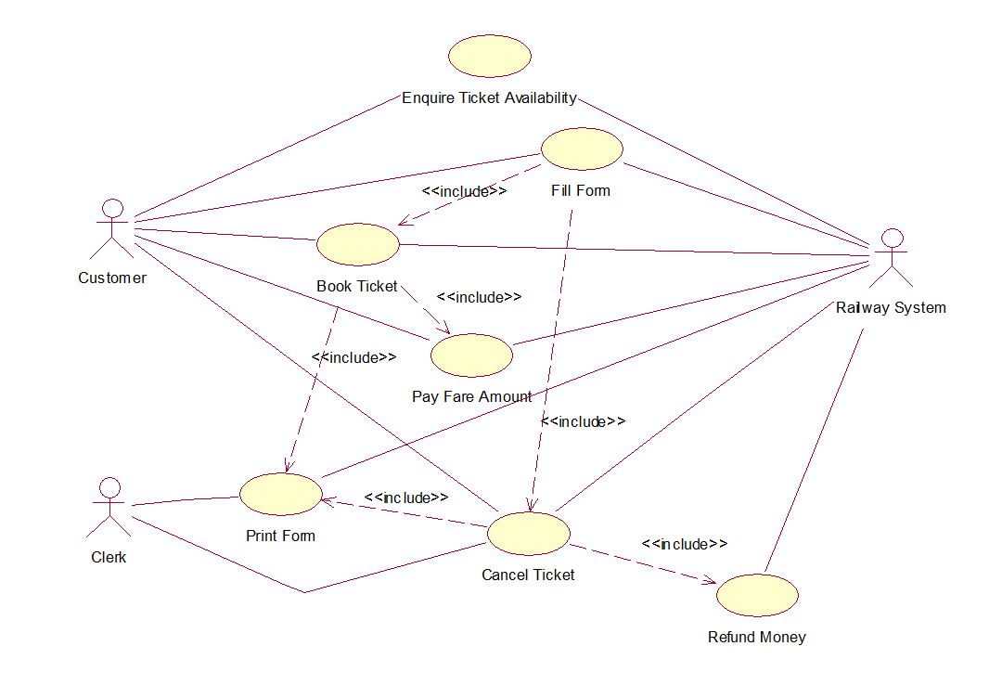
UML DIAGRAMS:
USE CASE DIAGRAM:

Slide 7
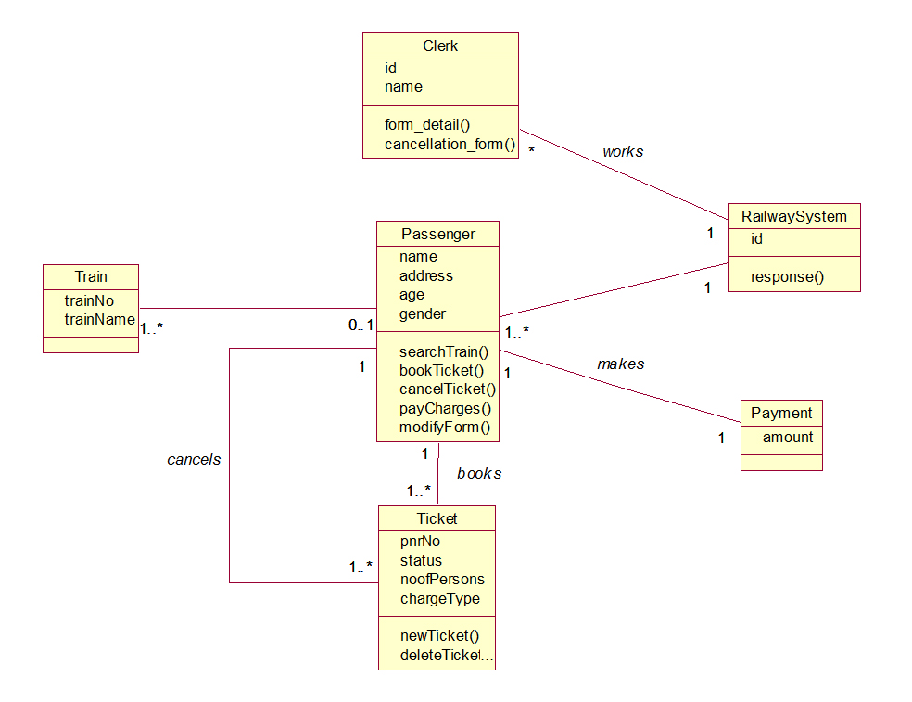
CLASS DIAGRAM:

Slide 8
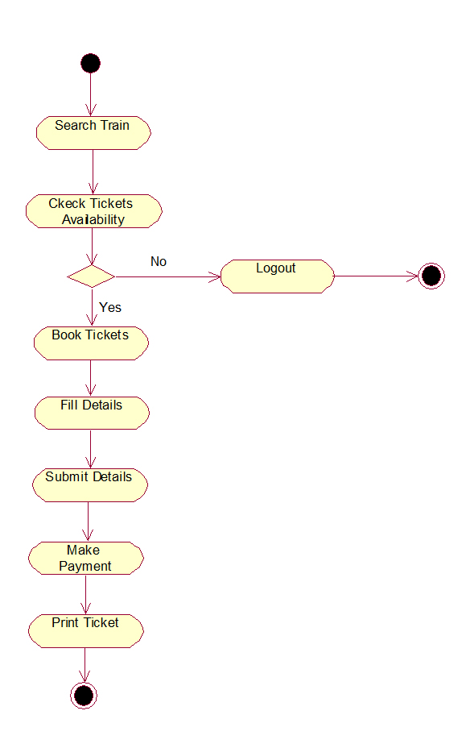
ACTIVITY DIAGRAM:

Slide 9
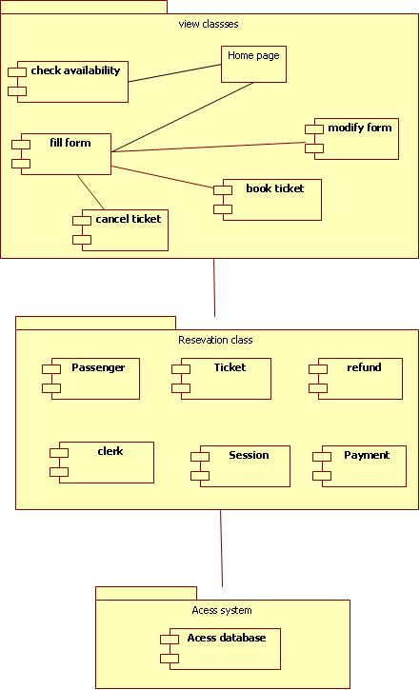
COMPONENT DIAGRAM:

Slide 10
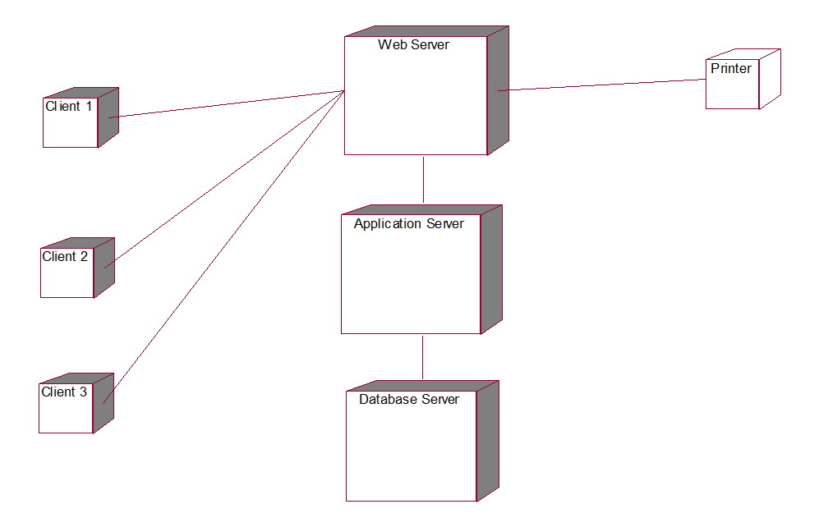
DEPLOYMENT DIAGRAM:

Slide 11
HARDWARE REQUIREMENTS:
Processor : Intel Core Duo 2.0 GHz or more
RAM : 2 GB or More
Hard disk : 50GB or more
Monitor : LCD or LED monitor
Keyboard : Normal or Multimedia
Mouse : Compatible mouse
SOFTWARE REQUIREMENTS:
Operating System : Windows 7 or Higher
Application : XAMPP or WAMP Server
Front End : PHP,HTML,CSS, Java Script
Back End : MySQL
Editor Tools : Notepad, Visual Studio Code
Web Browser : Google Chrome, Firefox, Brave

Slide 12
MODULES:
User Registration
Train Route
Ticket Module
User/Customer Details
Generate QR ticket

Slide 13
USER REGISTRATION:
This module covers the details about the registration of users which they can be register by itself by adding data like name, password, email id and further details. After registration they can be sign in by their username and password.
TRAIN ROUTE:
All the operations related to Train Route like source, destination, class, type of journey, no of tickets, ticket prices are managed in MYSQL database by this module.
TICKET MODULE:
All the user can able to create a ticket by clicking Book ticket button in homepage & To read a ticket by clicking Transactions button in homepage and delete ticket is managed admin from this module.

Slide 14
USER/CUSTOMER DETAILS:
All the user details like Name, Email Id, Password are entered by the users are managed by the admin in MYSQL database. Admin can able to remove the spam users from the database.
GENERATE QR TICKET:
After the payment successful the user can able to generate the QR ticket and user can able to print the ticket page by this module.

Slide 15
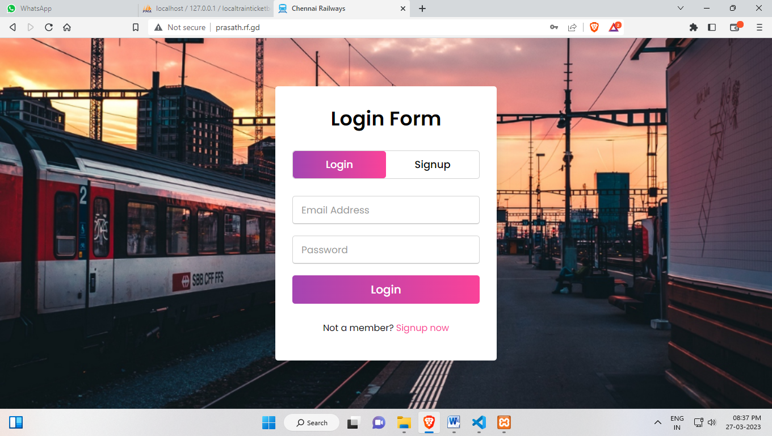
OUTPUT SCREEN:
LOGIN SCREEN:

Slide 16
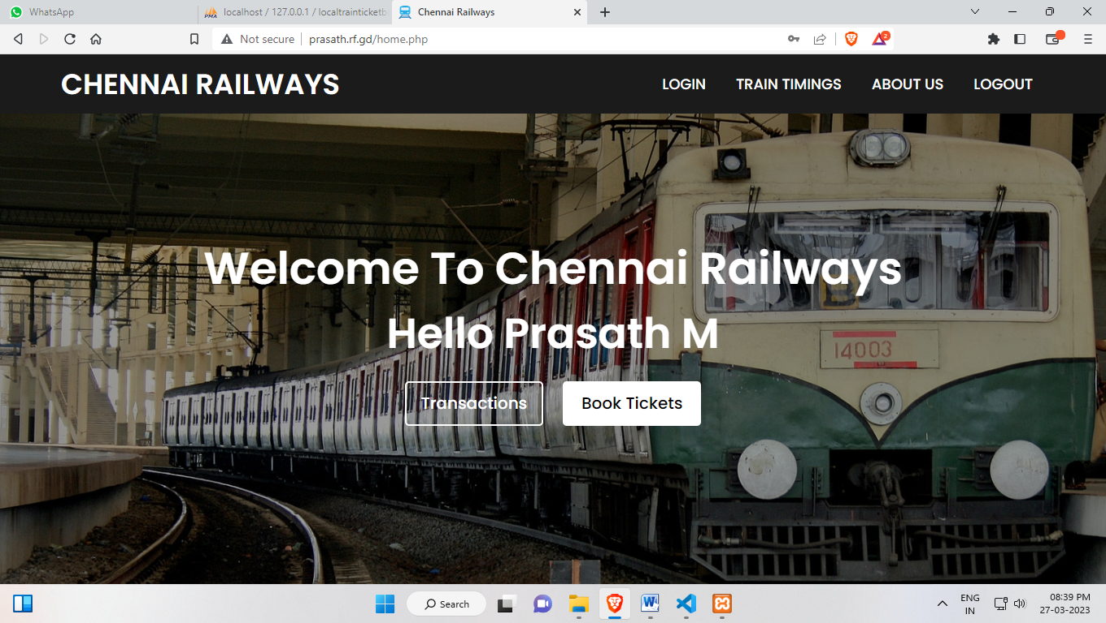
HOME SCREEN:

Slide 17
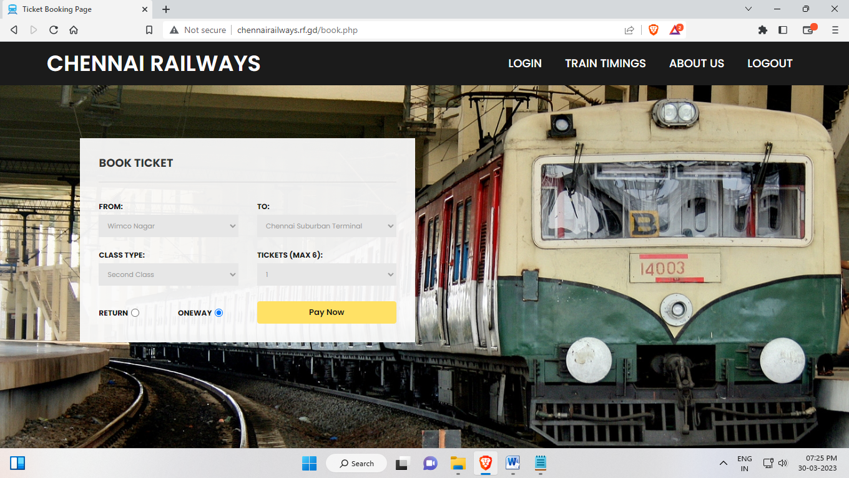
BOOKING SCREEN:

Slide 18
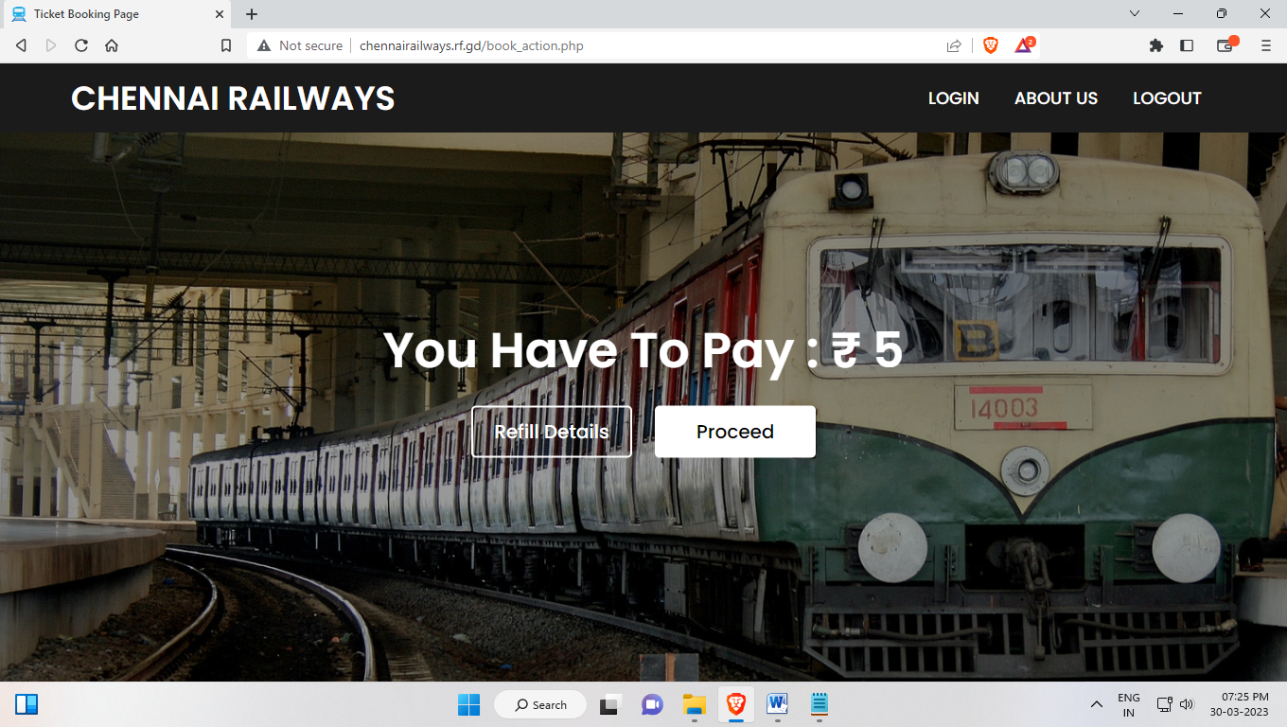
BOOK ACTION SCREEN:

Slide 19
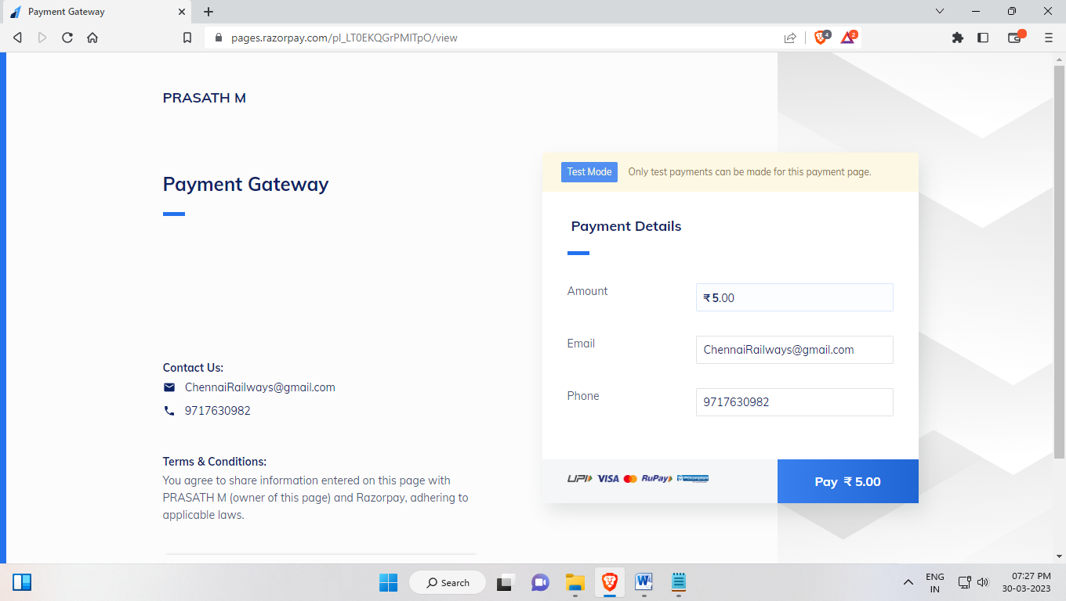
PAYMENT GATEWAY SCREEN:

Slide 20
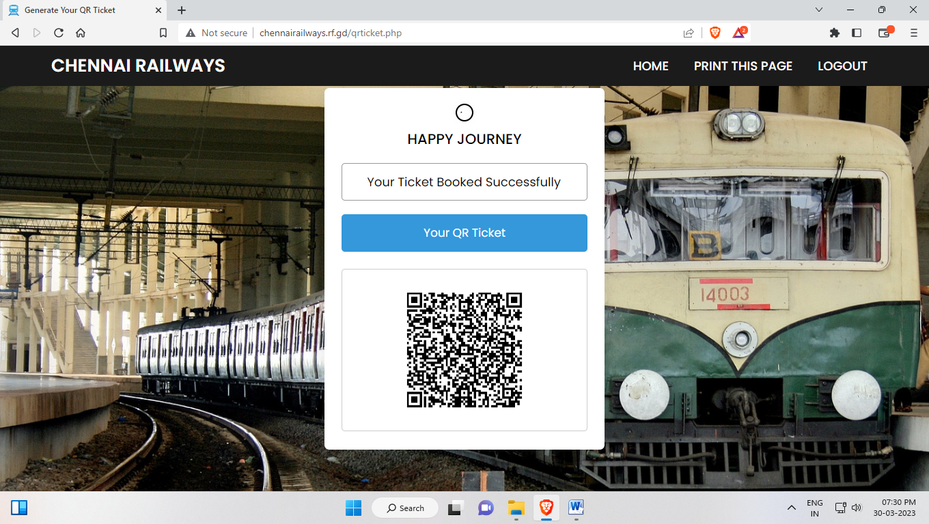
GENERATE QR TICKET SCREEN:

Slide 21
FUTURE ENHANCEMENT:
Future enhancement is very important for each project because it includes latest features in the system. It reduces software bugs and problems. It creates strong relationship with customers according their feedback or choices. I will integrate some dynamic features in my Online Local Train Ticket Booking System which features may integrate these are explaining briefly,
Latest design structure with seamless flow
E-mail and Mobile confirmation system

Slide 22
THANK YOU

